Slide 1
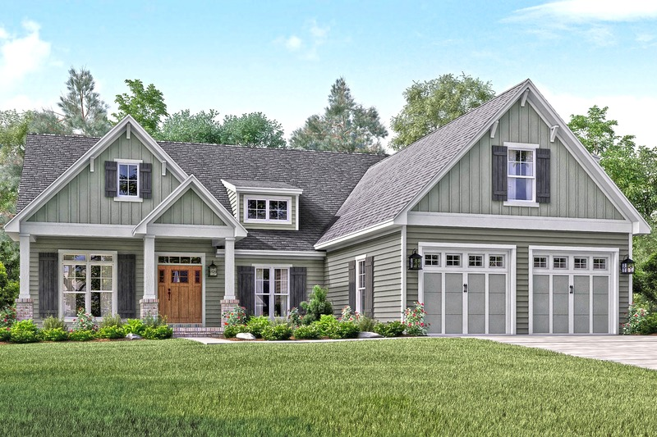
House price prediction machine learning model
By Group – Agent H
SangYeon Choi, Jiwon Cha, Basant Dhital

Slide 2
Project outline:
Why this project?
Project structure
EDA / Feature Engineering
How we built our House model ?
Hyperparameter tuning
Conclusion and future direction

Slide 3
Why this project?
Buying a house is lifetime investment. (House price according to features)
The real world problem are put in Kaggle, Zigbang, etc. to get solution using machine learning. These skills are in high demand in the market
The main goal of this project was to predict house price using machine learning algorithm. We made automated process (as possible) to apply machine learning opportunity to predict house price according to various features

Slide 4
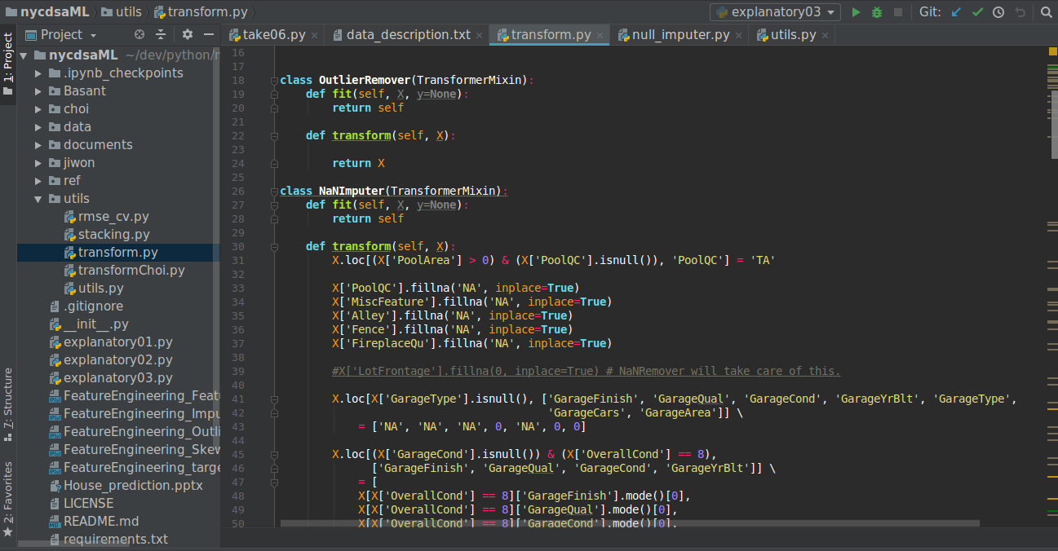
Project structure :
Simple but efficient co-op environment
we did research and shared new idea freely
When ides got matured, it was deployed in specific directory and controlled

Slide 5
contd…..
Pipelines for Fast iteration:
House Data
Number of transformers such as NaNRemover and Scaler
Data Transforming Pipeline
Transformed Data
Hyper parameter optimizers and model Stackers
Kaggle
Model Building Pipeline
Prediction

Slide 6
Some EDA visualization:
correlation between various features

Slide 7
contd……
Box plot of overallQual with outliers
Box plot of salesprice vs GarageCars after
removing outliers

Slide 8
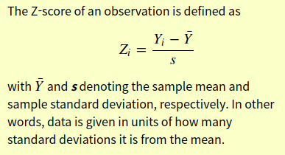
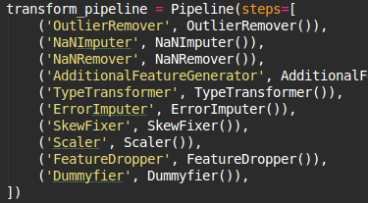
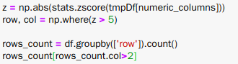
Automatic data transformer for outliers:
Z score
Created effective strategy
made a pipeline element

Slide 9
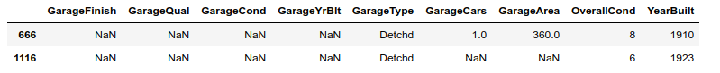
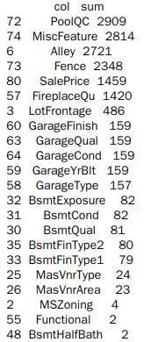
Data Transformations:
Used data_descriptions.txt and common sense to impute NAN data
Imputed NaN for garage related data by assuming that have similar value with those have same overallcond
31 out of 35 NAN containing columns are taken care of by manual NAN Imputer
This made big difference in kaggle score
List of NAN containing columns

Slide 10
How we built our House model ?
Start with Lasso ( Test / Feature Selection )
Fast and Good result
A few Parameter
Add Supervised Learning ML
Ridge / RandomForest / Boost ..
Comparison of results between various algorithms
Make Stacking / Average Model
To reduce residual, Make a Integrated model
It was possible to test all these models using pipelines that we built

Slide 11
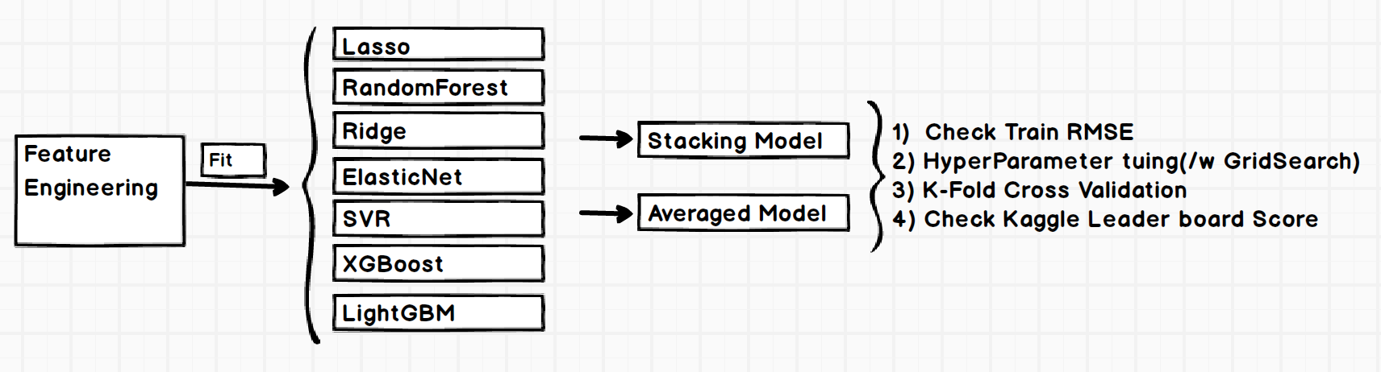
Final house model:
Workflow for Model selection
Used Various Algorithm
GridSearch for finding Hyperparameter
Made a Model ( Stacking / Averaged )

Slide 12
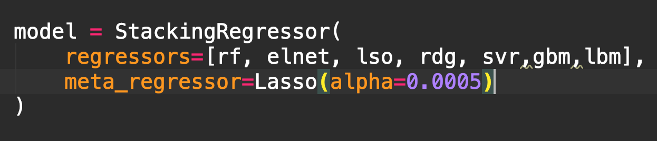
contd……
Stacking Regression: Two heads are better than one
Stacking is a method that combines
predictions of several different models
Various ML Algorithms can be mixed
Meta Regressor
An algorithm that combines different models
<http://rasbt.github.io/mlxtend/user_guide/regressor/StackingRegressor/>

Slide 13
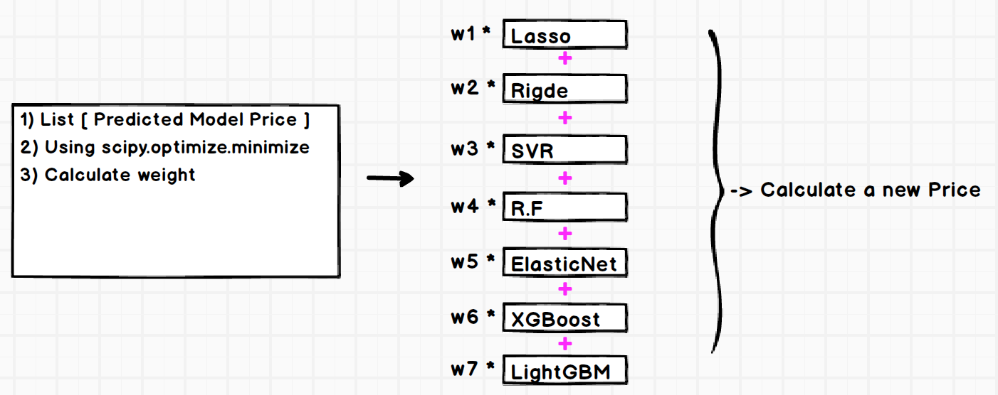
contd……
Averaged Model:

Slide 14
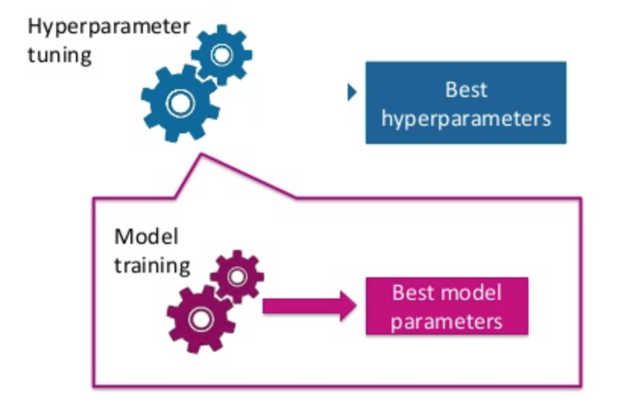
Tuning Hyper Parameter:
To make a better model is a very important process
We can adopt three different ways:
GridSearch
RandomSearch
Bayesian Optimization
And we choose GridSearch. Why?
Many references available
Easier to use and small data size

Slide 15
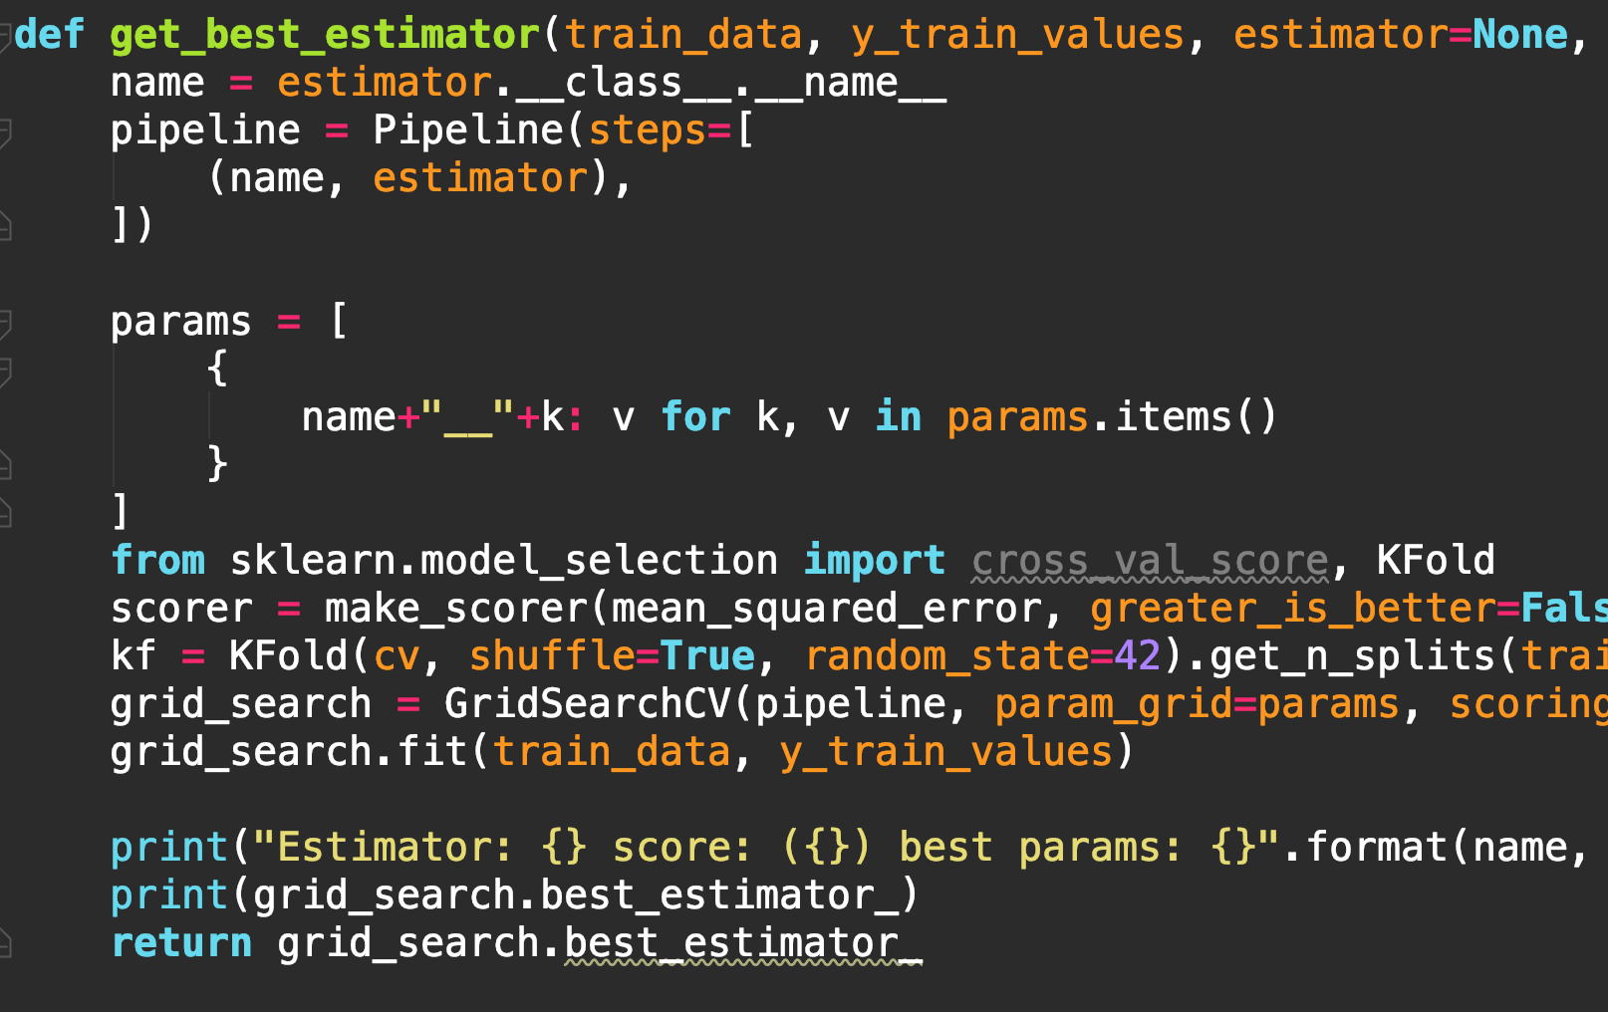
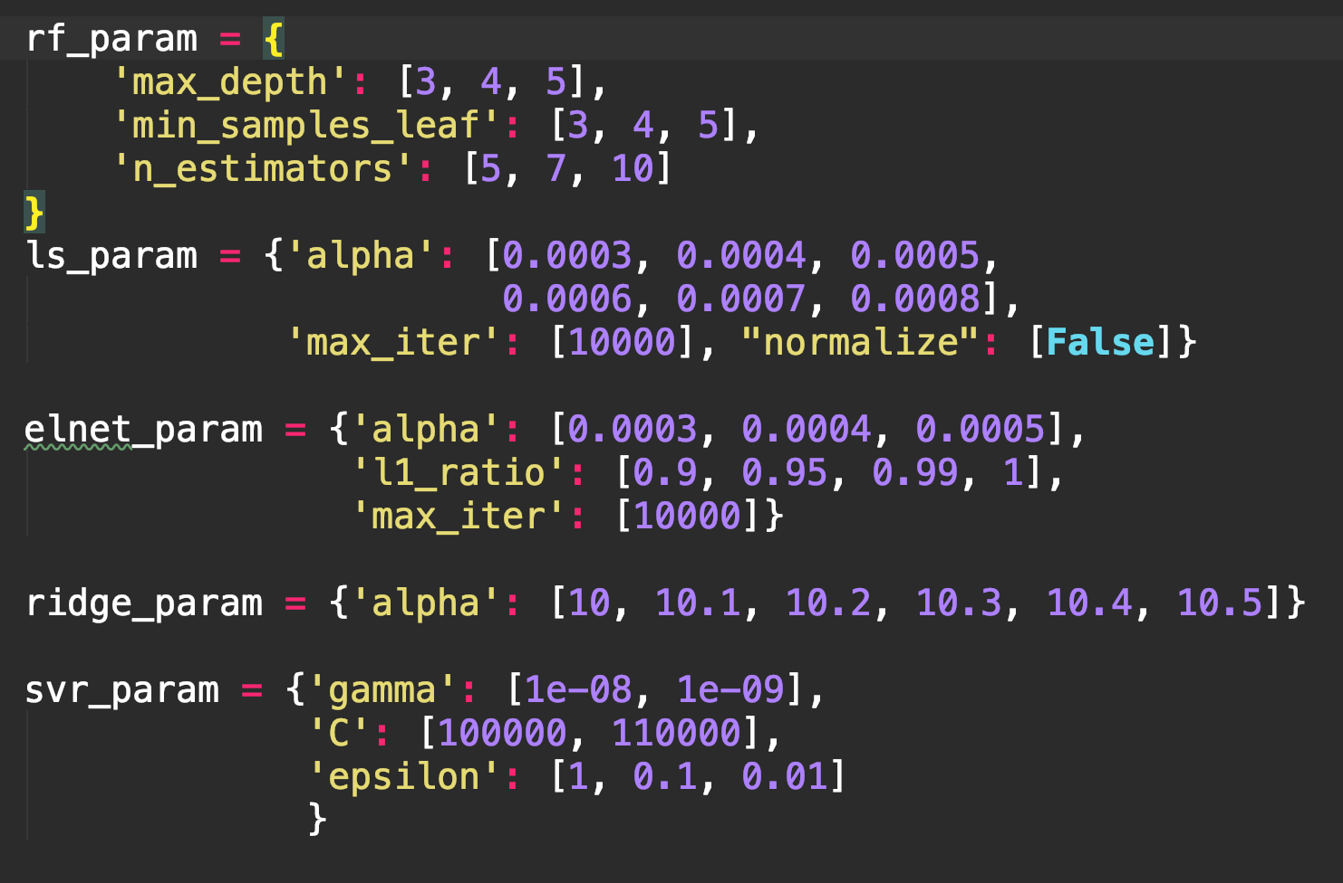
Used K-fold Cross validation = 5:

Slide 16
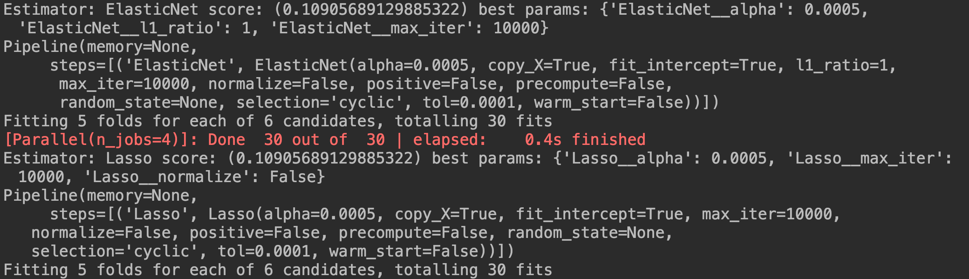
Find best parameter:

Slide 17
Result:
Simple model
Model | Train RMSE | Kaggle Score
ElasticNet | 0.10879657 | 0.11684
Lasso | 0.10869445 | 0.11691
Ridge | 0.11043459 | 0.11562
SVR | 0.11368618 | 0.12019
Randomforest | 0.15893652 | 0.17354
Xgboost* | 0.12115257 | 0.12965
lightGBM* | 0.13731836 | 0.14344
In our Case,
XG / light was not a good score.
- Boost Algorithm
- Need to tune the parameter
Better linear than tree
- Example( lasso > R.F )
House model
Model | Train RMSE | Kaggle Score
StackingRegressor | 0.11069786 | 0.11554
AveragingRegressor | 0.12458452 | 0.12066
StackingRegressor is better than AveragingRegressor
*did not use in our house model

Slide 18
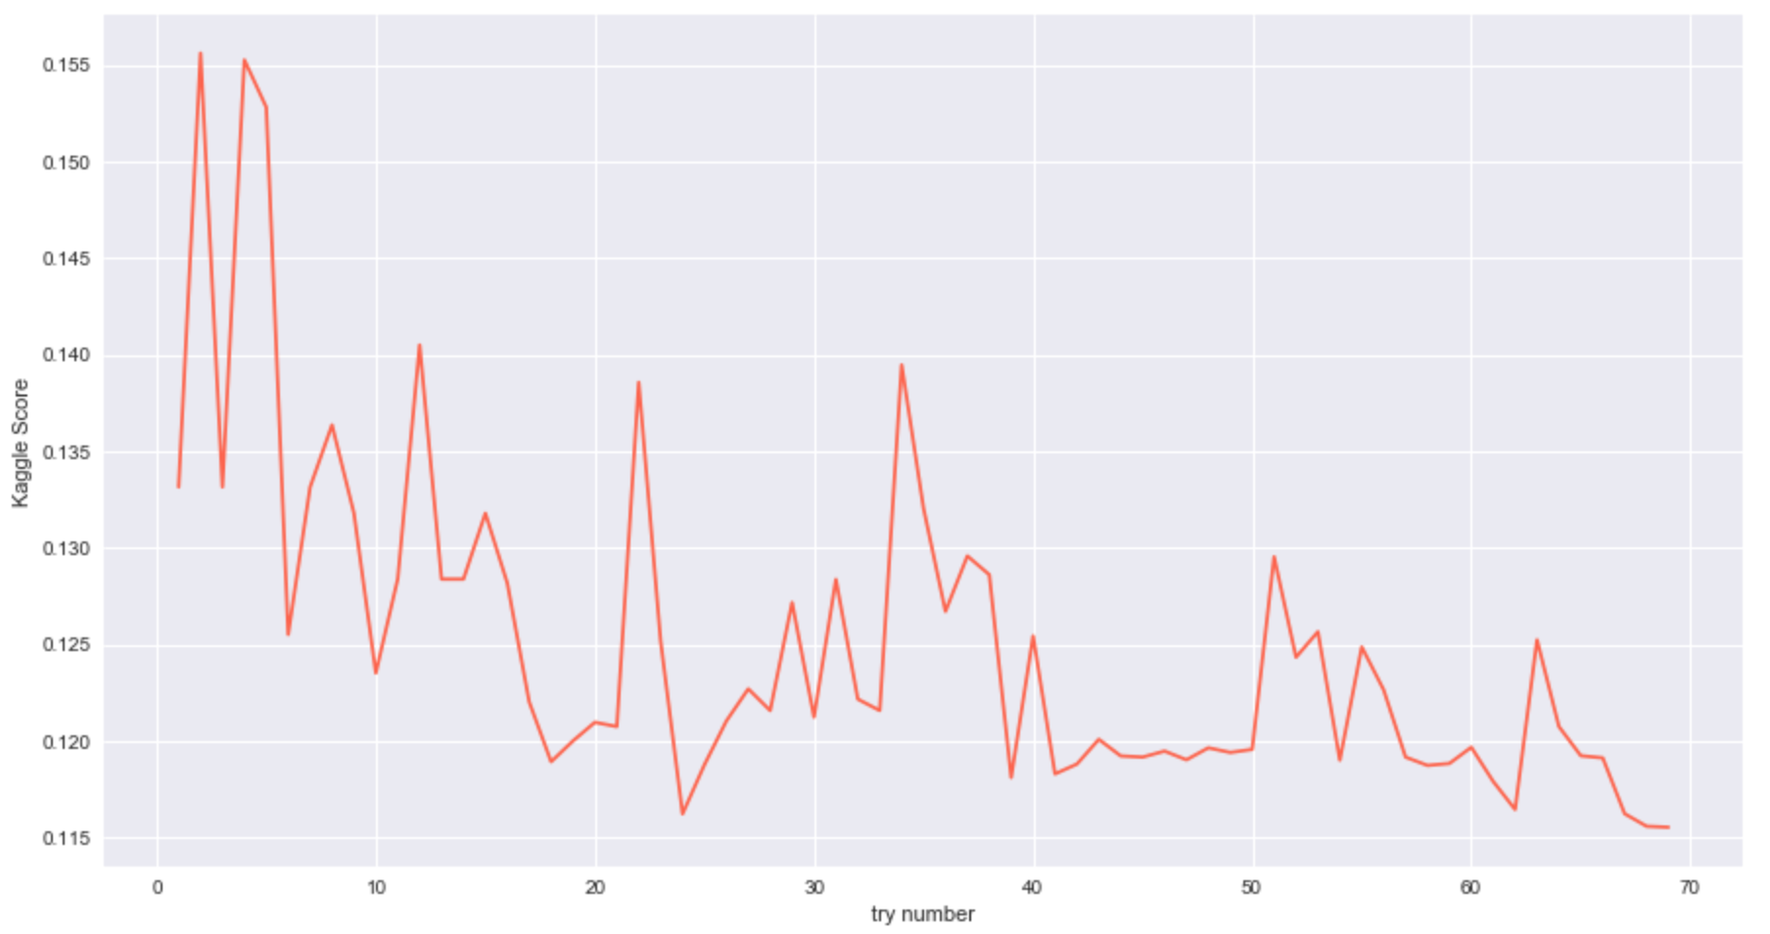
Kaggle result:
Top 8% ( 11/17/2018 )
Final Kaggle Score : 0.11554

Slide 19
Conclusion:
All of the parameters are important
Skewness , Z score and many variables to select
Tuning model hyperparameter
Feature engineering was most important to predict house price
FillNa ( 0 , Mode , median )
binning
Using domain knowledge
GBM/Xgboost powerful to give good benchmark solutions but not always best choice

Slide 20
Future directions:
Tune parameter for Xgboost, lightGBM model in future and predict better accuracy
Apply clustering analysis to create new features
Investigate more feature engineering
It would be nice to get time series event data and study the effects of 2008 recession
on house sale price and predict its effect in case of recession in future

Slide 21
Thank you
very much!!!!

Slide 22
Project Result:
Achieved Rank 500 by moving fast, failing fast

Slide 23
EDA contd…
Fixing NA’s and outliers

Slide 24
EDA processing:
Checking normality of the data
Initial distribution of data
Distribution of data after log transformation

Slide 25
Data Transformations:
But most of null imputation is done manually
since Auto imputer performed poorly
Hardcoded NaN Imputer engages first,
And then,
simple auto NAN imputer takes care of the rest.

